Slide 1
Getting Asynchronous in NodeJS
Alex Schwartz | Madison WI

Slide 2

About Me
Full-Stack Developer/Consultant with Robert Half Technology
QA Automation Engineer for Sony
12+ Years experience
Geek/Nerd
First Time Speaking at Conference
Only person who thinks I’m funny

Slide 3


Slide 4


Slide 5
Questions?

Slide 6


Slide 7
Questions?
Like | Comment | Subscribe

Slide 8
What This Talk is About
JavaScript Basics
NodeJS
Asynchronous Programming Concept
Callback Methods
Promises
Advantages/Disadvantages
Common Pitfalls
Adding Async To Your Code
Future State

Slide 9

What This Talk is Not About
Installation/Execution of Node
Building Node Projects
Working with NPM
Best Coding Practices for JavaScript
Every Way to Do Async

Slide 10
Setting the Stage with JavaScript
Introduced 1995 – Currently on ES8
Initially developed for client-side practices
Event-Driven
Standard API
I/O Not Part of Standard Package
Influenced numerous other languages/scripts
ActionScript
CoffeeScript
Jscript
.NET
Notes:
Detail the basic elements of Javascript and the current state of things
-Current frameworks
-History of the language through today
-Server-side vs client-side
CoffeeScript: JavaScript with Syntactical Sugar (Pattern matching)

Slide 11
JavaScript Basics
Event-Driven Loop
Odd Scoping/Context
Seamless Connection between Server/Client
Difficult to Follow | Difficult to Debug
Framework-Driven
Package Hell
https://hackernoon.com/how-it-feels-to-learn-javascript-in-2016-d3a717dd577f
Newest = Better

Slide 12
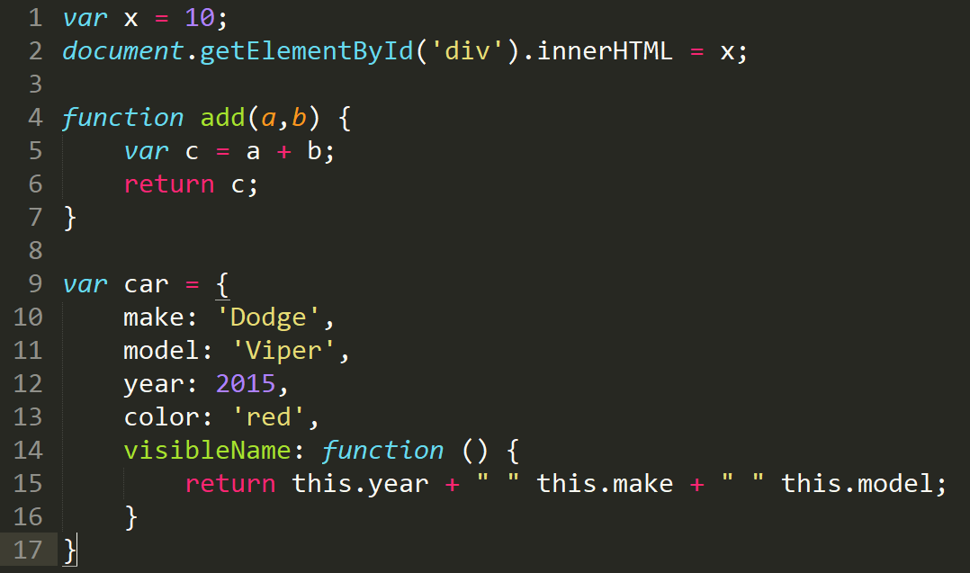

Slide 13
Why Is JavaScript Popular?
Client/Sever Connection
Fast
Community-Driven Packages and Modules
Cross-Browser Support
Responsive Design
NodeJS | Server-Side
OOP Prototyping
Optional JIT
Notes:
Potentially Skipped slide – detail the basics of javascript

Slide 14

Dark Side of JavaScript
Event-Driven Loop
Framework Hell (Third-Party Issues)
Changing ES versions
Versioning
Security
Loose-Typing (Typescript Fixes This)

Slide 15

NodeJS
Server-Side JavaScript
Event-Driven, Non-Blocking IO Model
Fast, No Buffer
Highly Scalable
Utilizes ES syntax and Standard JavaScript
Development and Automated Testing
Notes:
Putting in details about the language itself, how it works and how it functions

Slide 16
When To Use NodeJS
Best Utilized In:
I/O Intensive Applications
Data Intensive Applications
API Intensive Applications
High-Speed Web Applications
Pairs well with numerous front-end frameworks
Ember
React
Angular
Backbone

Slide 17
Utilizing NodeJS
Express WebServer
Meteor (Full Stack Design)
Sails
KOA
Useful Frameworks:
Babel – Transpile
Lodash – File Handling
Notes:
Express - Minimalist framework for creating web/mobile applications
Meteor – MVC framework that combines front-end and back-end
Sails – MVC data-driven APIs
KOA – MVC interactive API

Slide 18
What is Asynchronous Programming?
Parallel Execution of Code
Unit of Work Independent of main thread
Multi-Threaded Execution
Responsive User Response with Background Activity
API Calls
Database Writing
File Reading/Writing
Non-Blocking Event-Driven Programming

Slide 19
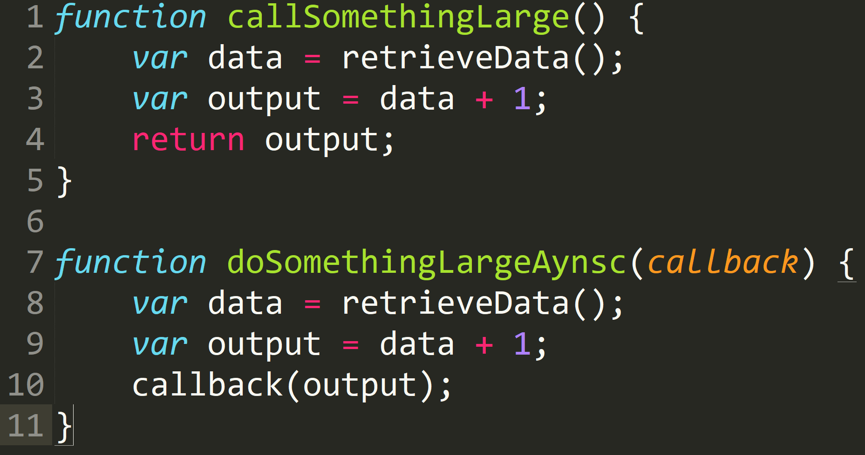
History of NodeJS Async – Feedback Loop
m
Callback called when “done”
Synchronous Inside Function
Callbacks tell Event Loop when it is “Ready” and “Done”
Event Handlers Perform Same Function

Slide 20
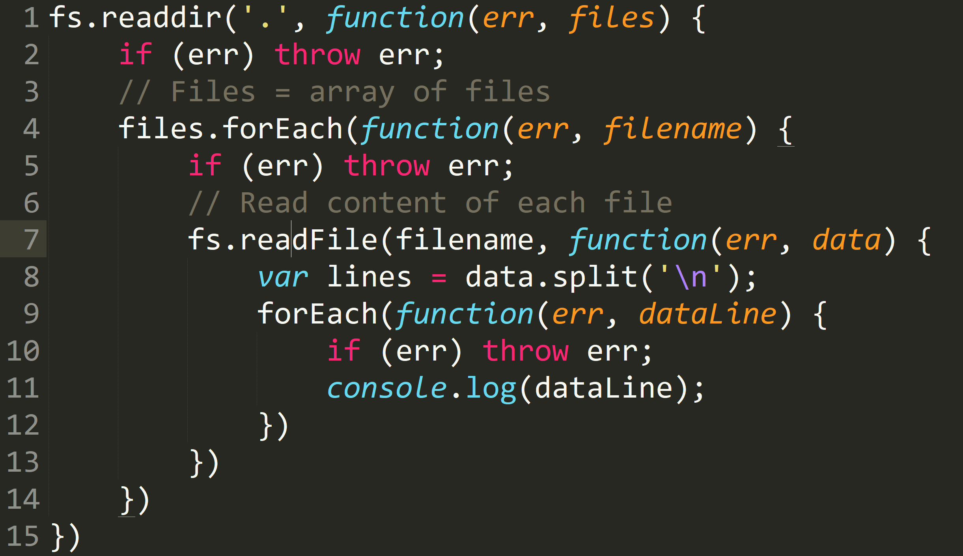

Slide 21
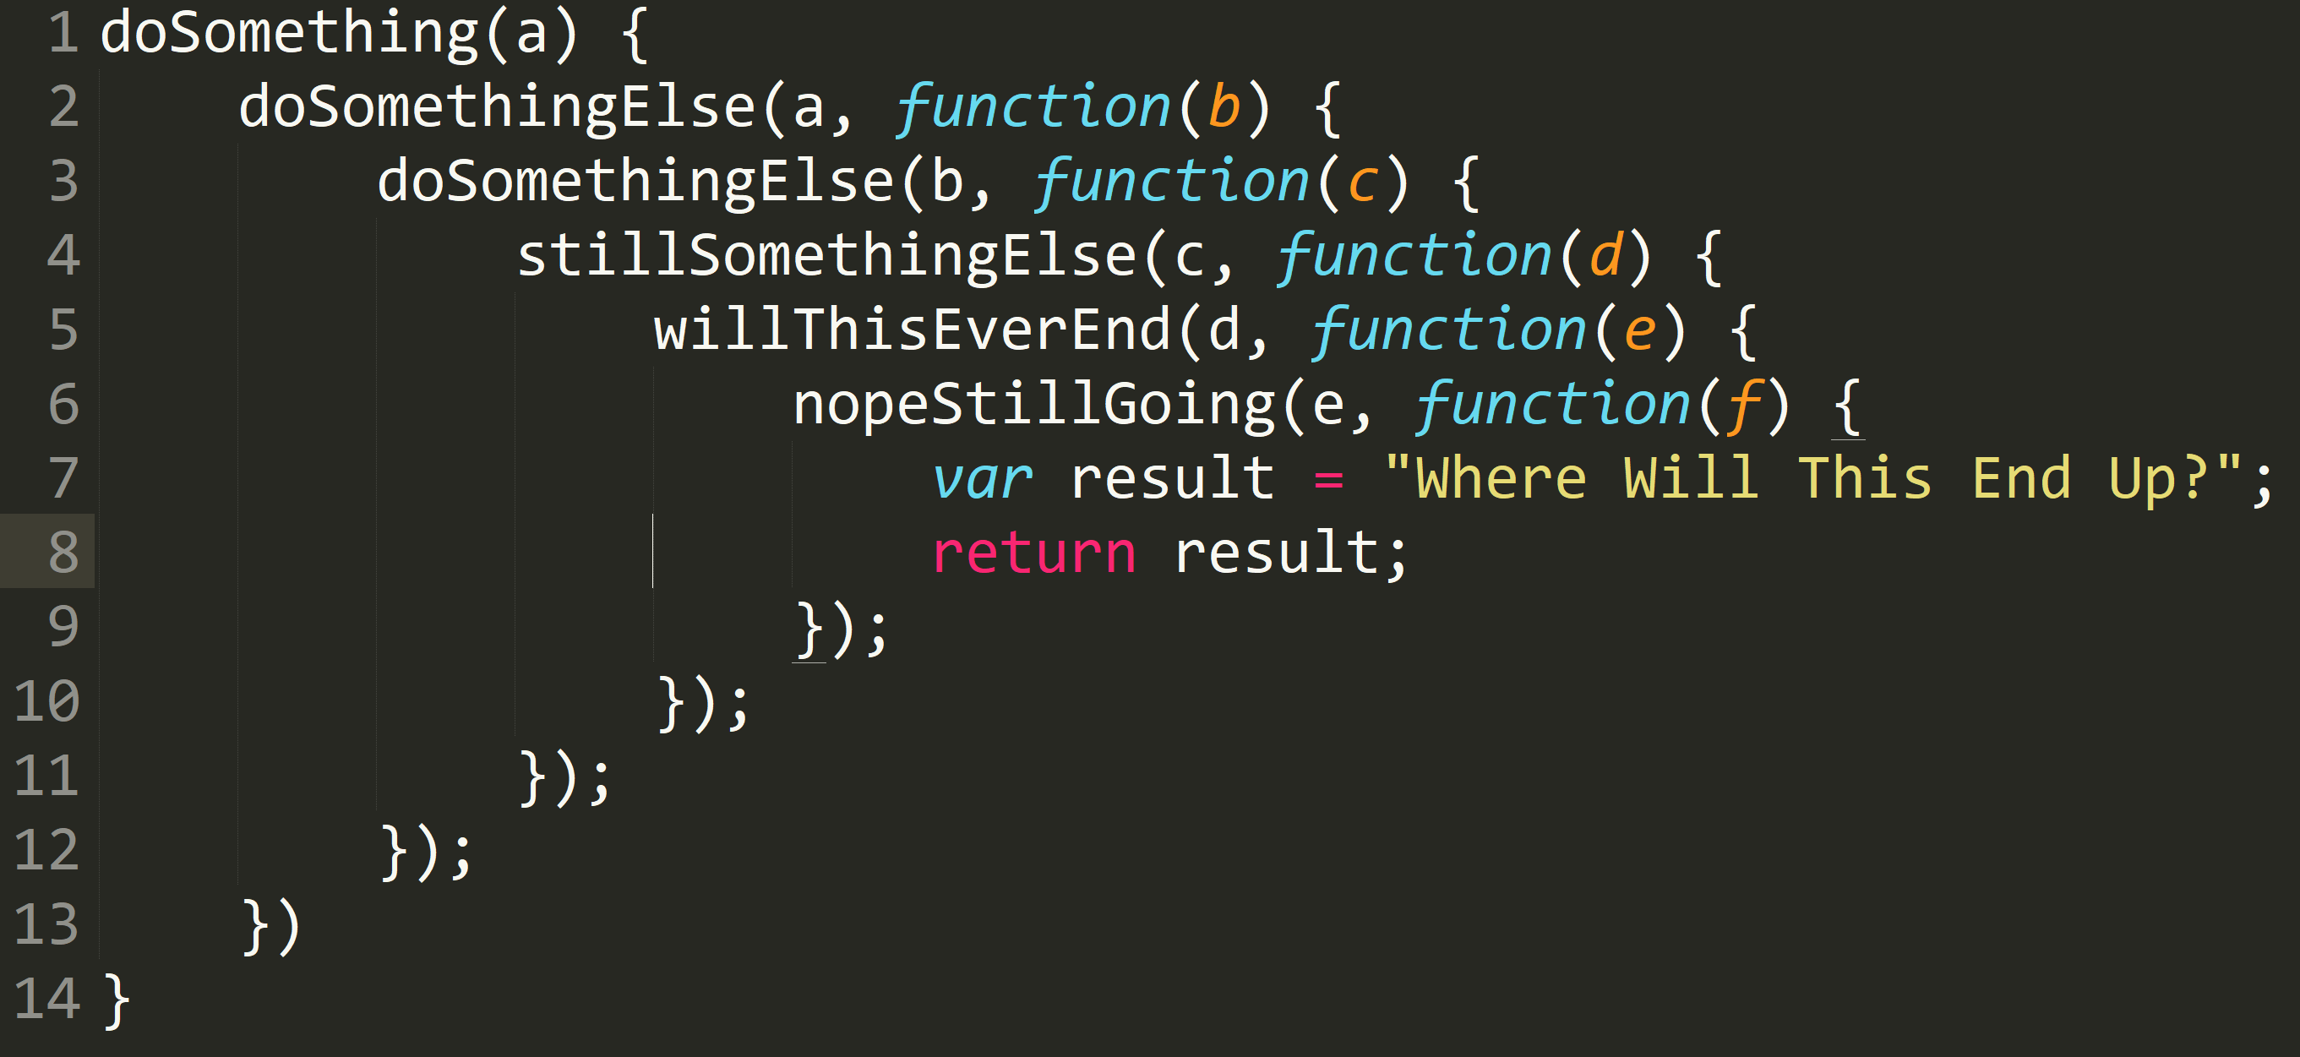

Slide 22
Async Module – The First Step
Framework designed to cleanup the codebase
Handles Internal Promises
Allows Parallel Execution of Asynchronous Modules
Cleans up the Callback Hell

Slide 23
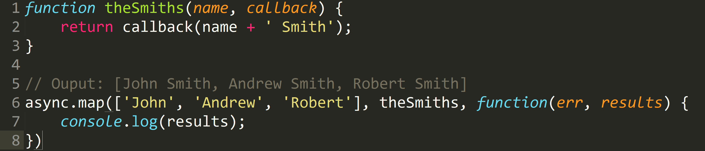

Slide 24
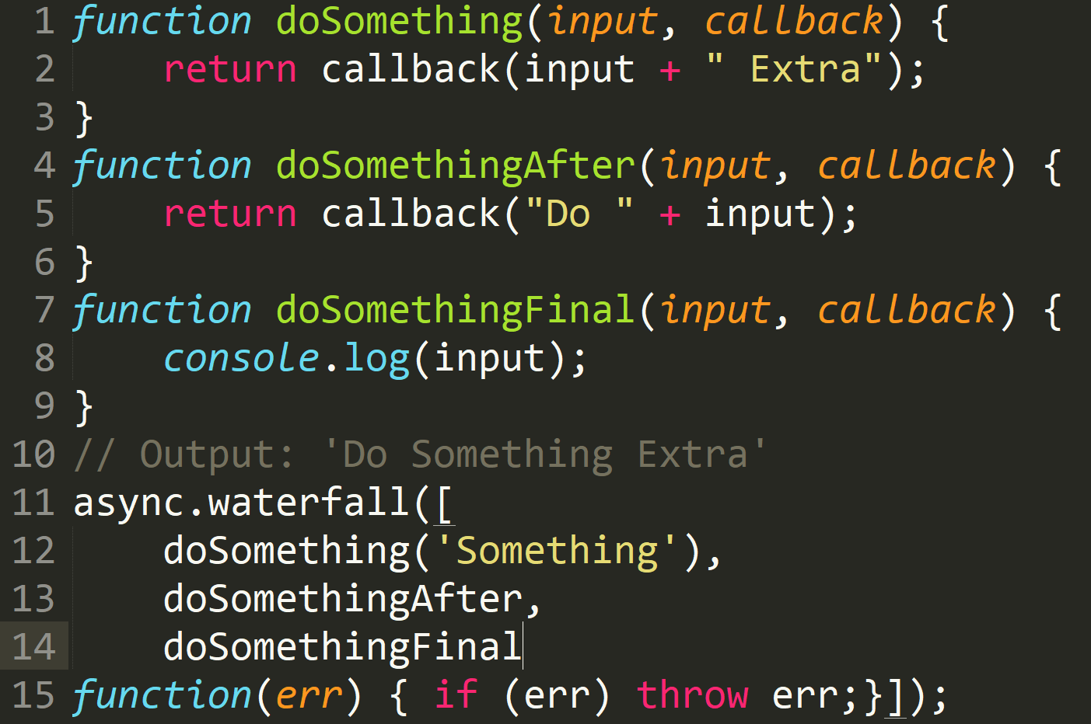

Slide 25
Problems
Current method requires modularization
Upfront costs are high
Doesn’t only “Wait” when necessary
Need “Pending” State

Slide 26
Promises – A Better Way
Method to “wait” for a value to return
Failure Handling
Four states
Fulfilled | Rejected
Pending
Settled
Allows code execution to continue passing along a Promise
Wait only when necessary

Slide 27
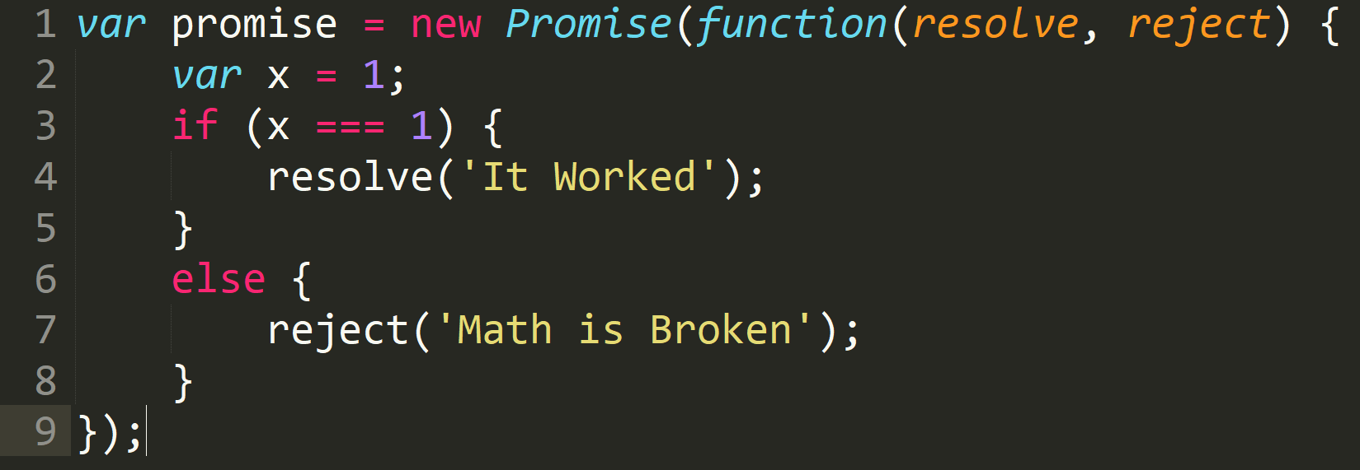

Slide 28
Promise Chaining
Utilize new ‘then()’ operator to serialize code
Chain them together passing promises along the way
Standard execution occurs in parallel/async as needed
‘catch()’ grabs and passes any errors up the stack
Can now asynchronously chain our methods together in a simpler format

Slide 29
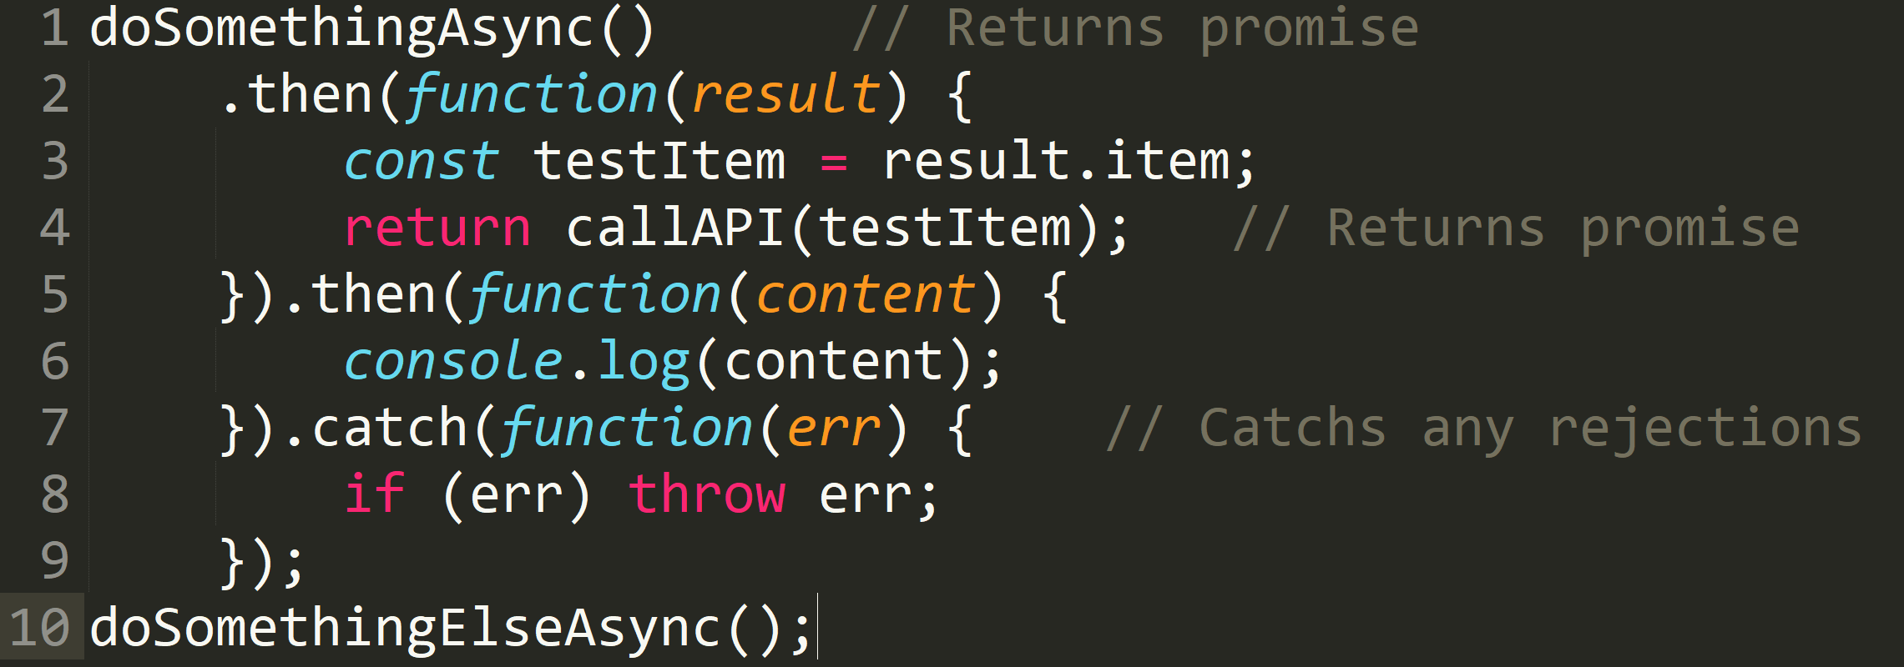

Slide 30
Advantages
Performance Boost when Used Correctly
Strong UI/UX Performance – eCommerce/Stores
Data-Intensive Applications
Promises -> Easy Determination of Async/Sync
Error Handling
Modular Code Cleanly

Slide 31
Disadvantages
Race Conditions
Non-Standard Approach to Development
Code executed in “blocks” or “modules”
Even Senior Devs Have Issues
Unique Approach from Non-Programmers
Harder to Debug | Non-Obvious Solutions

Slide 32
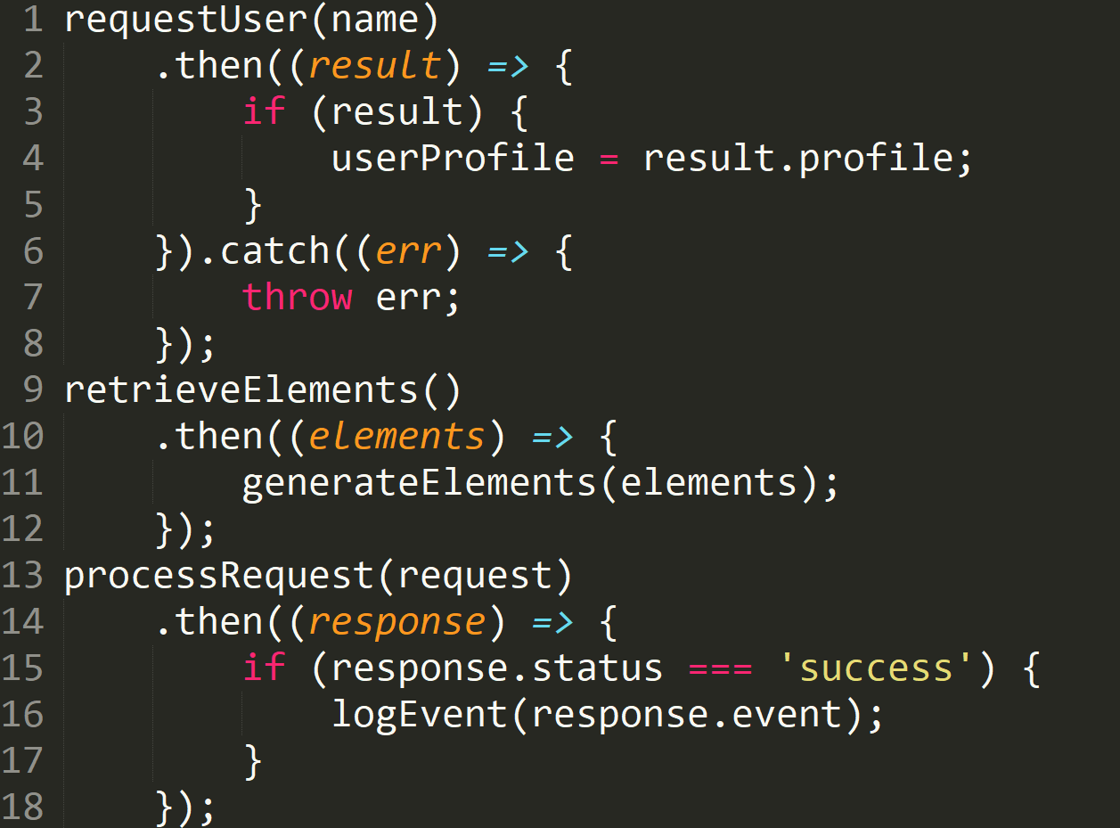
Notes:
Example – API Endpoints

Slide 33
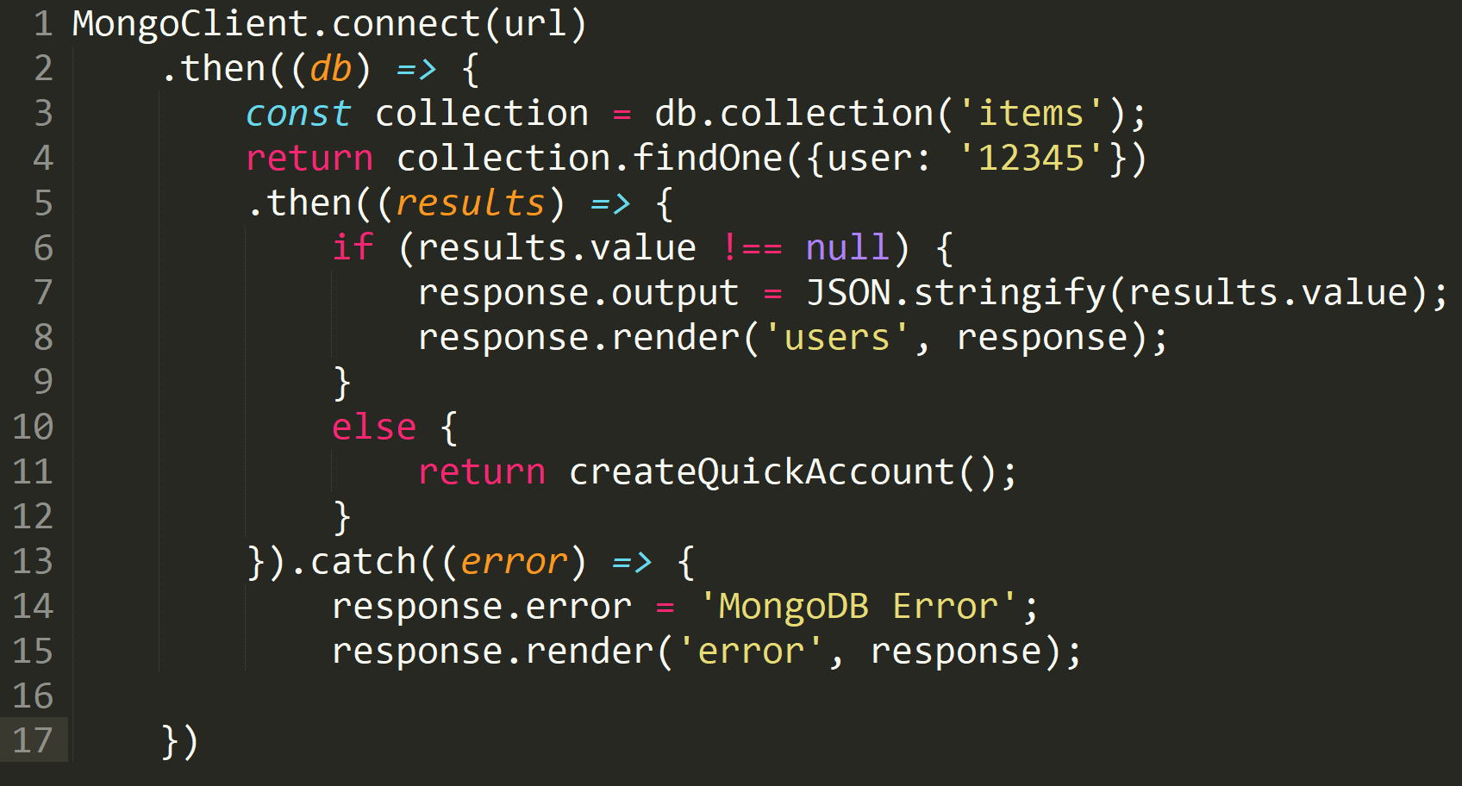

Slide 34
Common Pitfalls
Database Connections
Variable Assignment
Returning Promises vs Handling Them
Form over Function

Slide 35
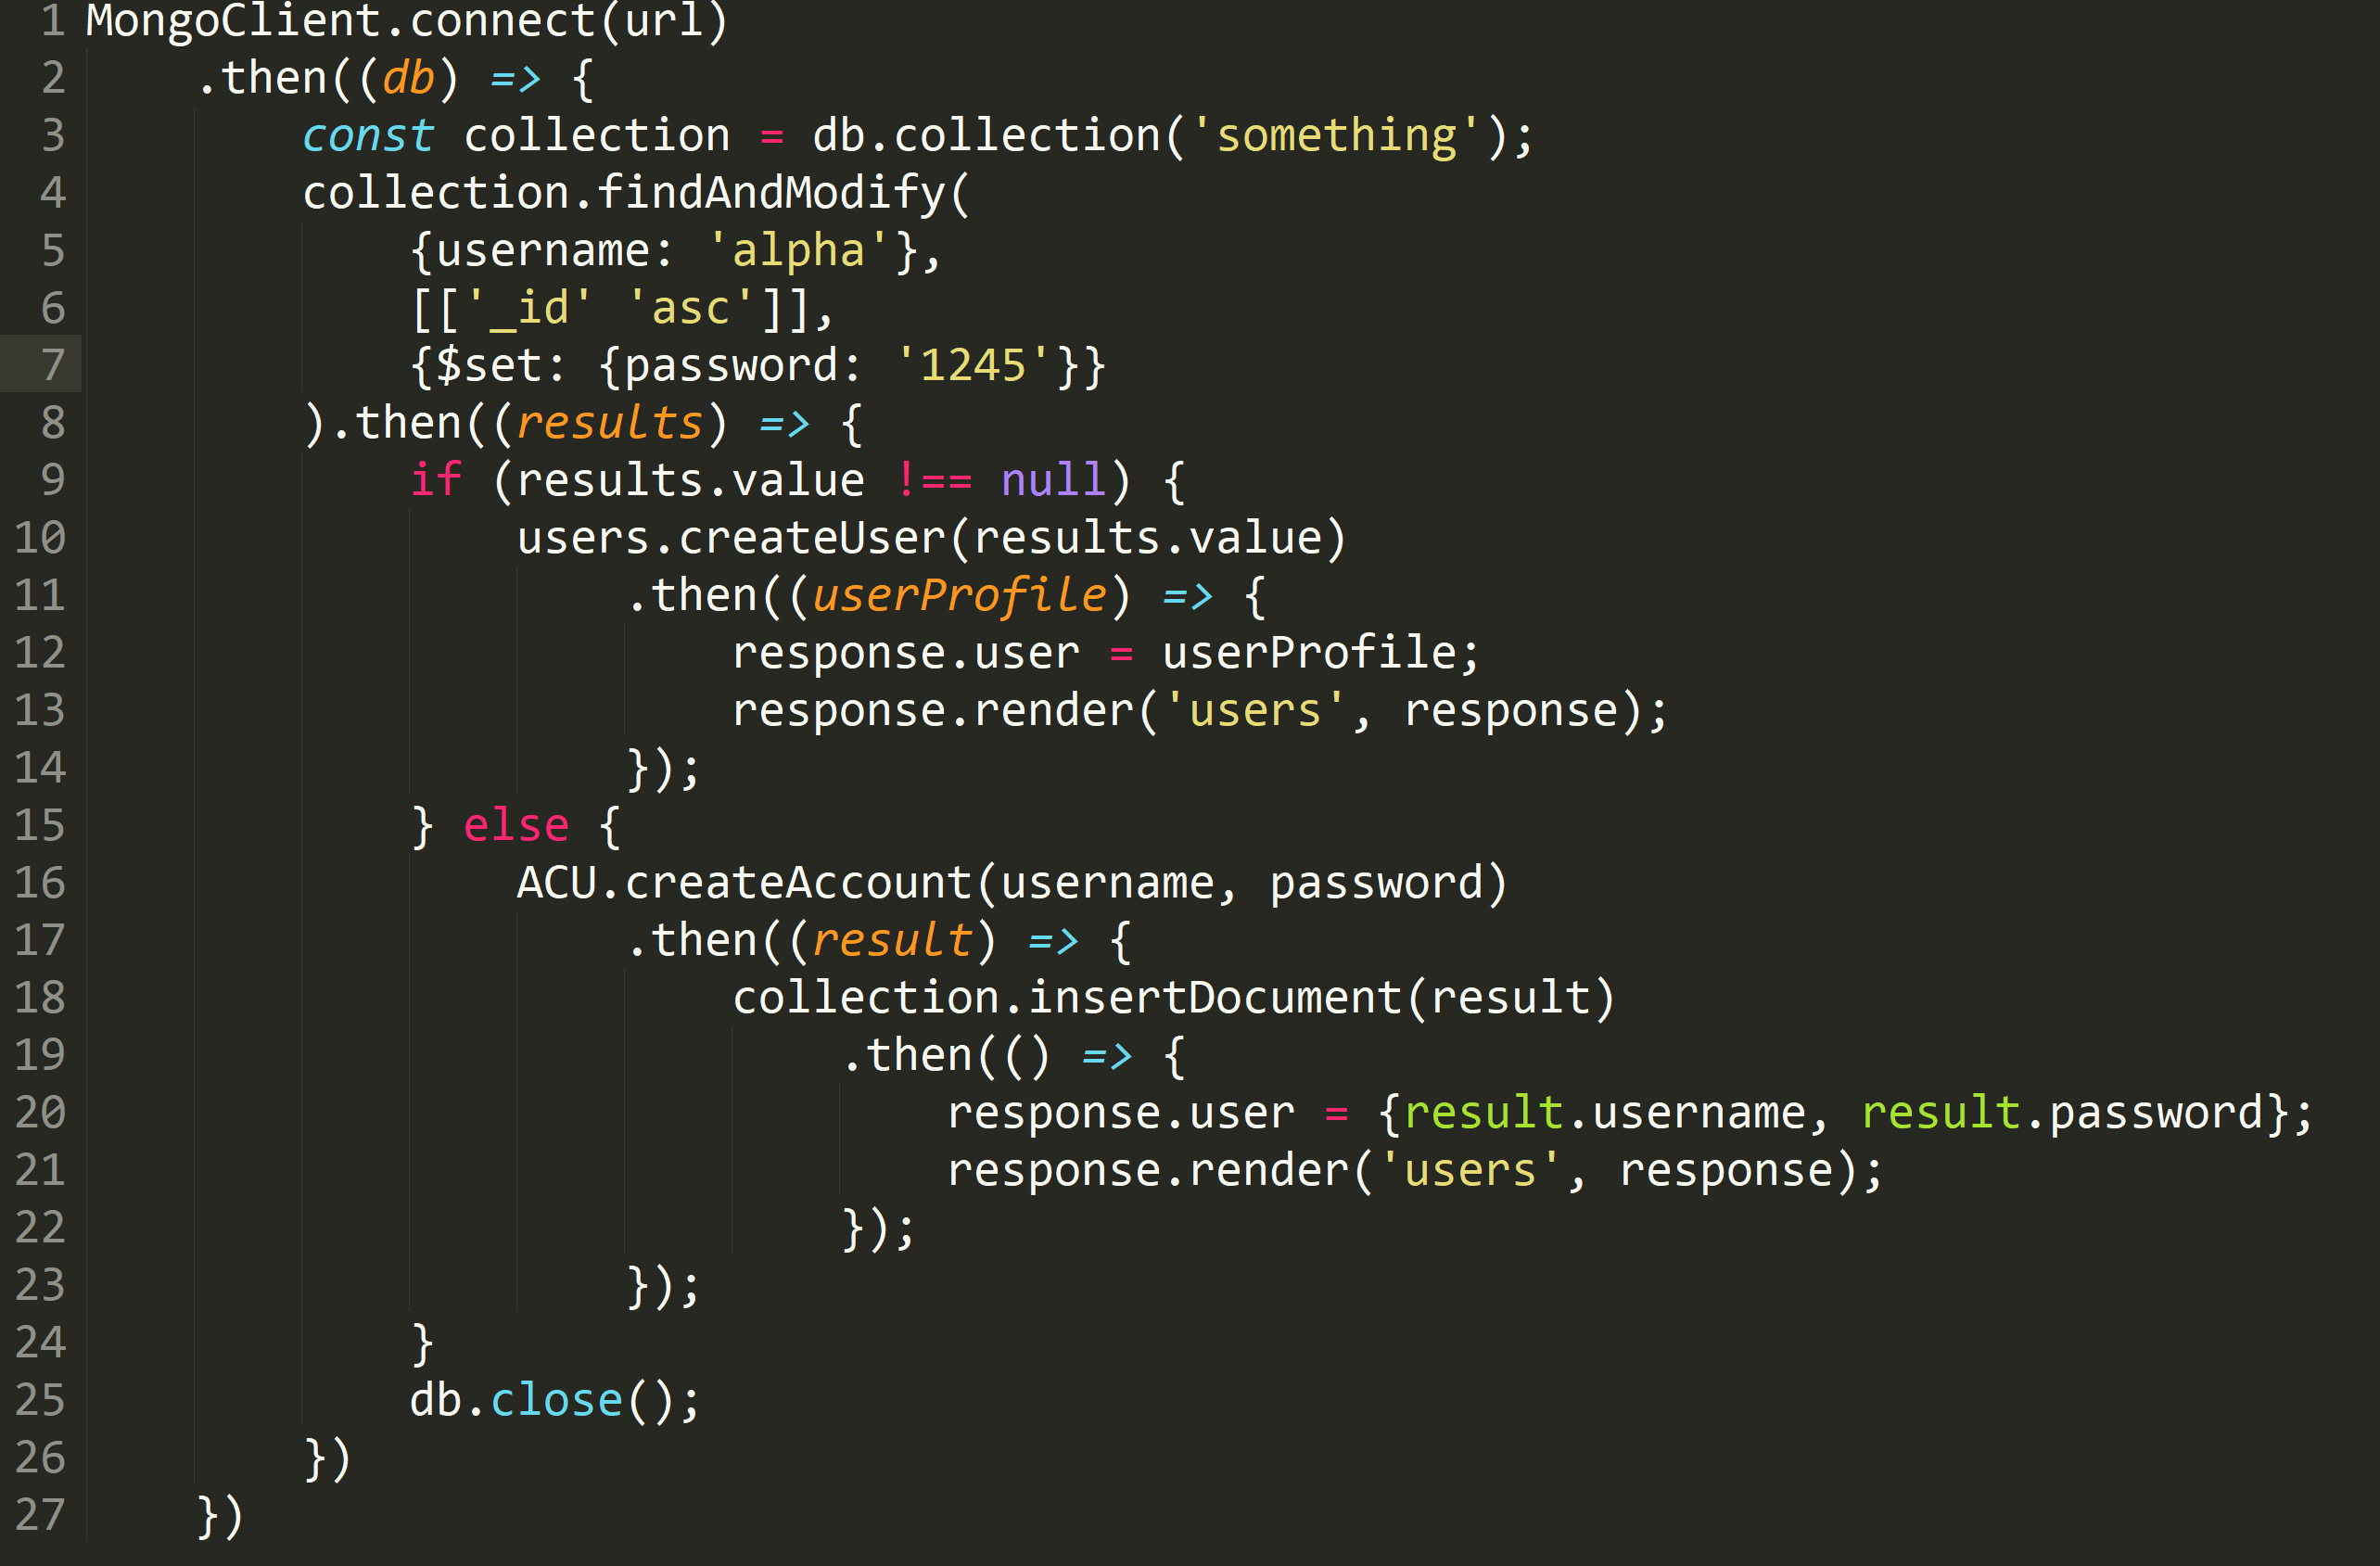

Slide 36
Older Methods
ES6 brought native support for Promises
Older modules
Q
RSVP
WinSync
Promises supported with Transpiling

Slide 37
Adding Async to Your Code
Used in Class Object Design
Diagram/Outline Code and Design First
Use Only When Necessary
Keep Code Modular For Ease of Reading
General Coding Standards Really Help

Slide 38
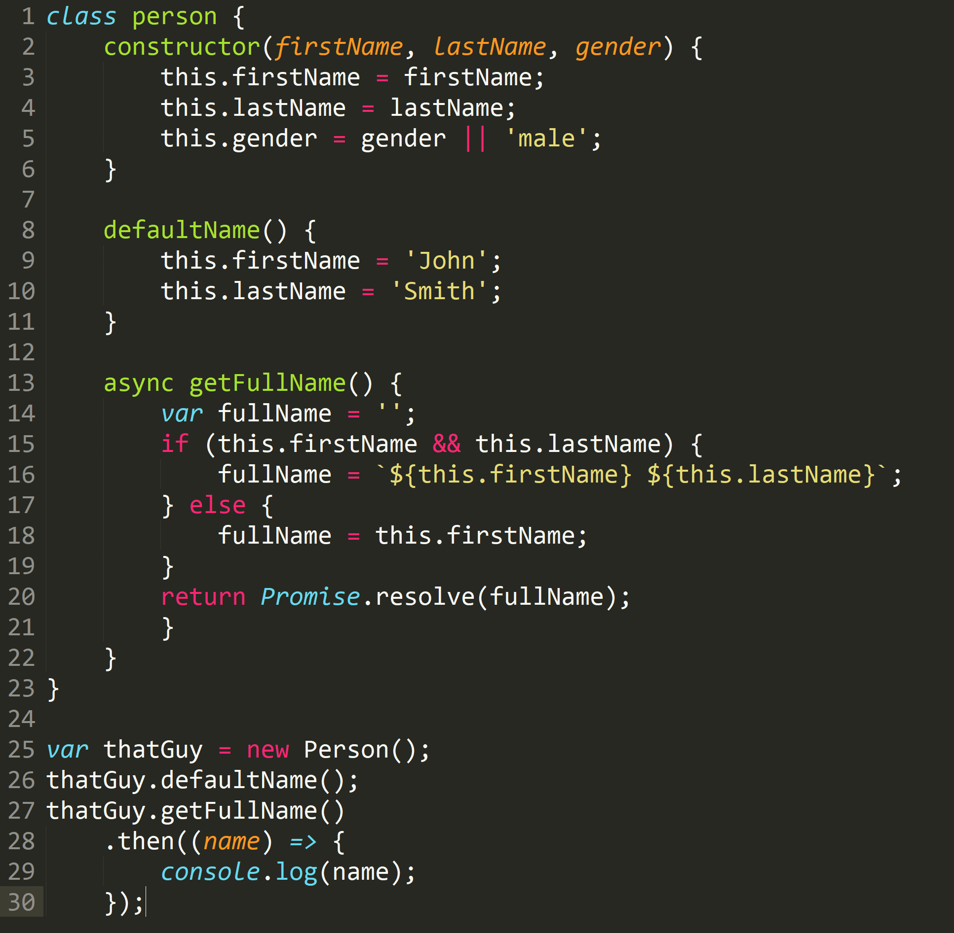

Slide 39
Current State and Future
Numerous APIs and Frameworks Deliver Promises Now
Async/Await Syntax Cleans up JavaScript Considerably
Simplifies execution path
Easy Storage of Promises
More Frameworks Embracing Async Code
Seeing Async in other Languages

Slide 40
Summary
Basics of NodeJS/JavaScript
Early Concepts of Asynchronous Coding
Callbacks and Modular Code
Promises
Promise Chaining and Combining with Async Modules
Advantages/Disadvantages
Common Pitfalls
Future State

Slide 41
Questions?
Presenter: Alex Schwartz | Madison, WI
Twitter: @TheRedGamer
LinkedIn: https://www.linkedin.com/in/alex-schwartz-83164b3a (Search Alex Schwartz Madison, WI)
Email: alex.schwartz1550@gmail.com
Questions Beyond This Presentation? Please Find me After!

Slide 42
Topics To Talk To Me About
Video Games (Overwatch, LoZ: Breath of the Wild)
Competitive Chess
Aerospace Engineering
Madison, WI
Comic Book Characters
Why I Suck at Fighting Games
Why I Suck at FPS Games
Anything At All Really

